Slide 1

Smart Librarian
ONN WEI CHENG A0092201X
YANG JIESHEN A0003901Y
NIRAV JANAK PARIKH A0213573J
ISA-PM-IPA-2021-01-09-IS02PT
https://ychef.files.bbci.co.uk/976x549/p03gg1lc.jpg

Slide 2
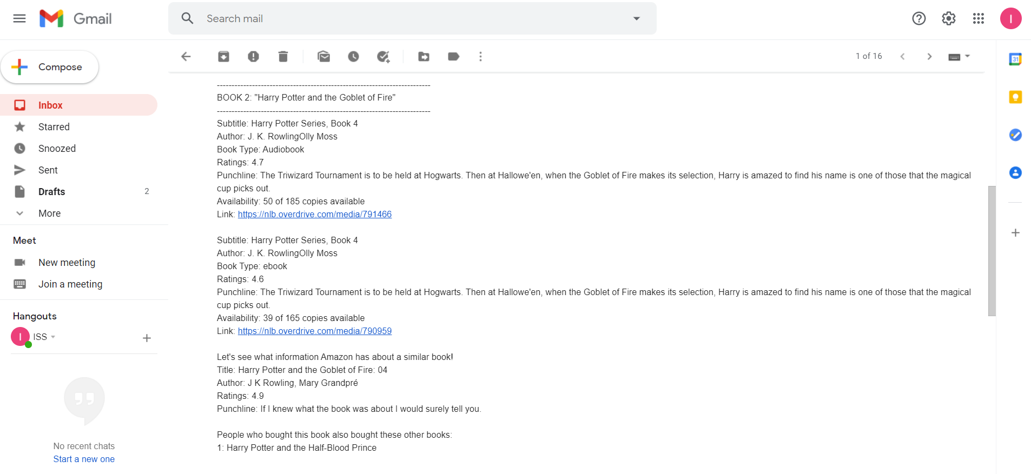
Value Proposition
Hello! I am your friendly neighbourhood Librarian. What book would you like to borrow from NLB?
I would like to borrow Harry Potter and the Goblet of Fire.
-------------------------------------------------------------------------
BOOK 1: "Harry Potter and the Goblet of Fire"
-------------------------------------------------------------------------
Subtitle: Harry Potter Series, Book 4
Author: J. K. RowlingOlly Moss
Book Type: ebook
Ratings: 4.6
Punchline: The Triwizard Tournament is to be held at Hogwarts. Then at Hallowe'en, when the Goblet of Fire makes its selection, Harry is amazed to find his name is one of those that the magical cup picks out.
Availability: 39 of 165 copies available
Link: https://nlb.overdrive.com/media/790959
Let's see what information Amazon has about a similar book!
Title: Harry Potter and the Goblet of Fire: 04
Author: J K Rowling, Mary Grandpré
Ratings: 4.9
Punchline: If I knew what the book was about I would surely tell you.
People who bought this book also bought these other books:
1: Harry Potter and the Half-Blood Prince
Would you like to enquire about another book? Current book list: Harry Potter and the Goblet of Fire
No
Ok! I will send you an email on the ratings and availability of the books that you have enquired. Thank you and Goodbye!
The availability, ratings, punchline and recommendations of selected books will be shared via email.

Slide 3


System Architecture
User Input & Output
Conversational UI
RPA Controller
User Intent Handling
NLB Availability Checker
Intelligent Title Matcher and Abstract Summary
Amazon Recommendation System
Input from user through text or voice
Response Handling
Email for User

Slide 4
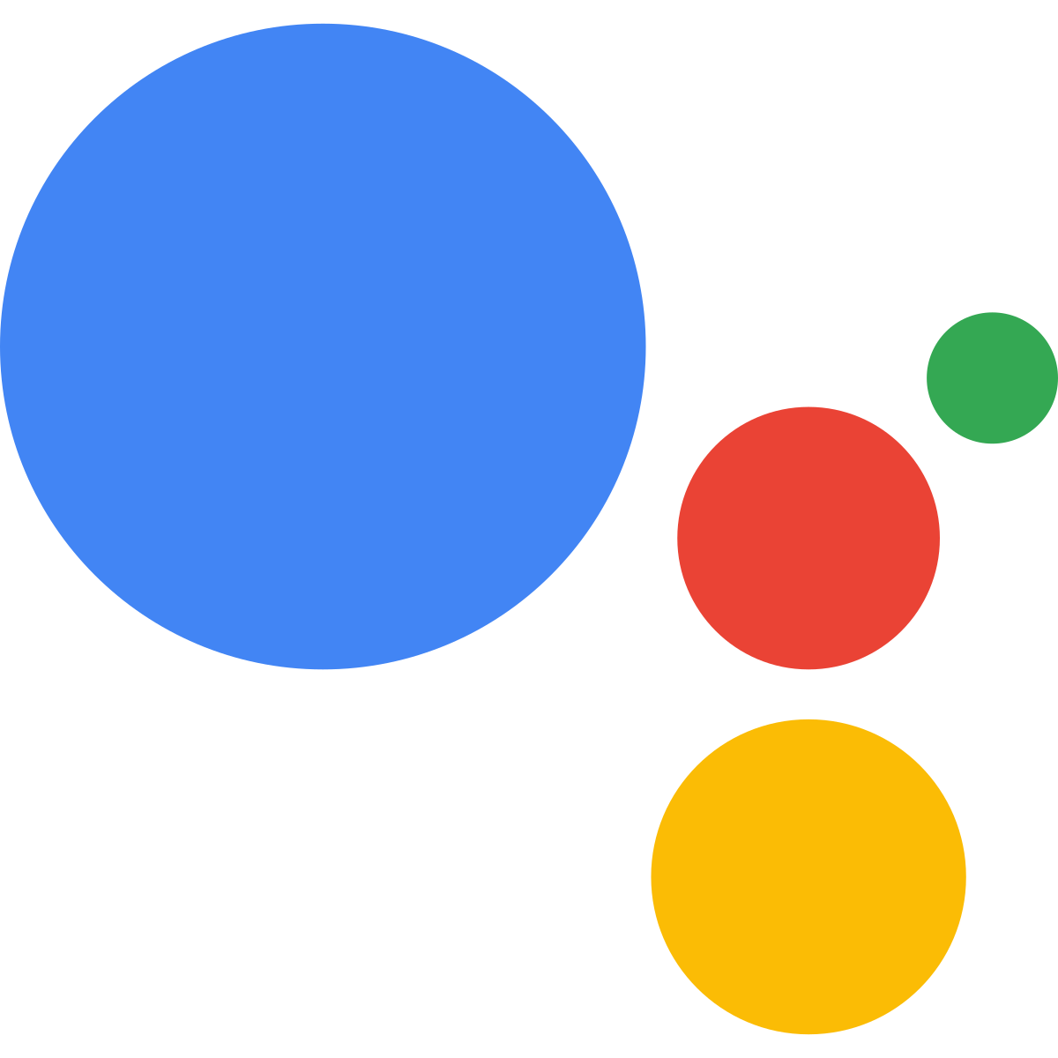


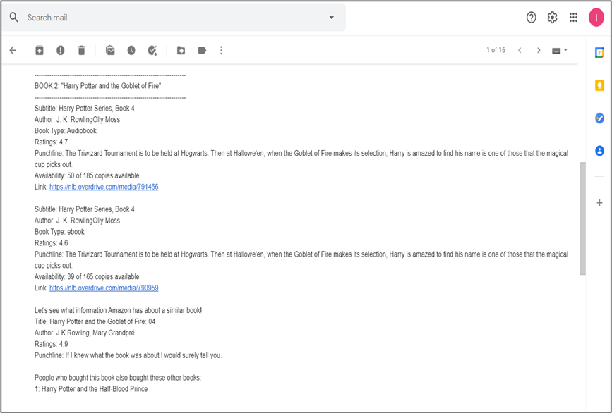

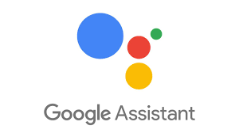


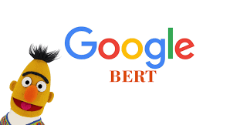
Technical Explanation of Use Cases
Conversational UI & Email
NLB Availability Checker & Amazon Recommendation Systems
Intelligent Title Matcher & Abstract Summarizer
Powered by UI Tag
Powered by Bert

Slide 5

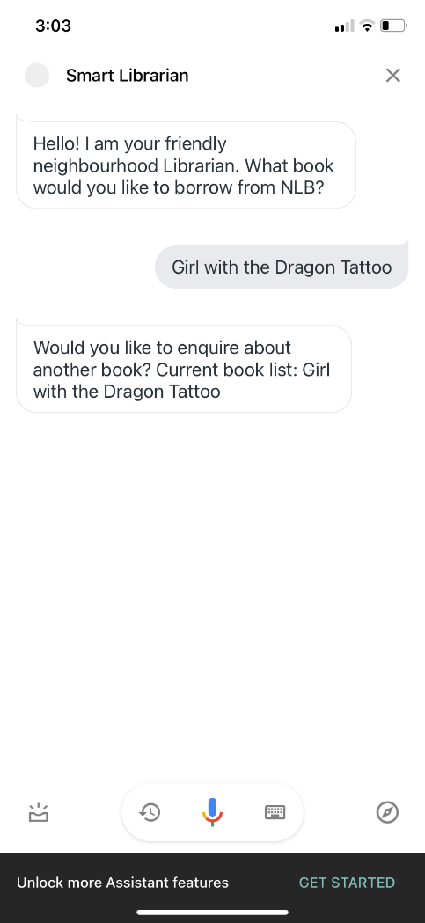

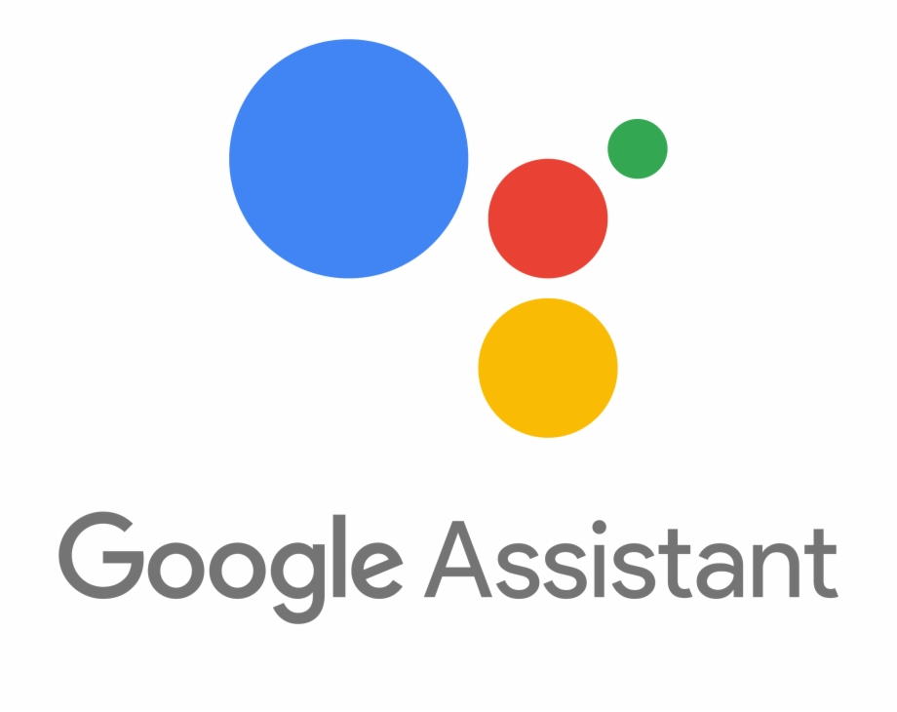
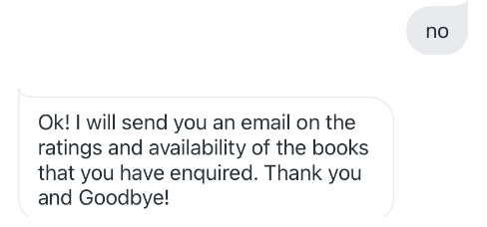
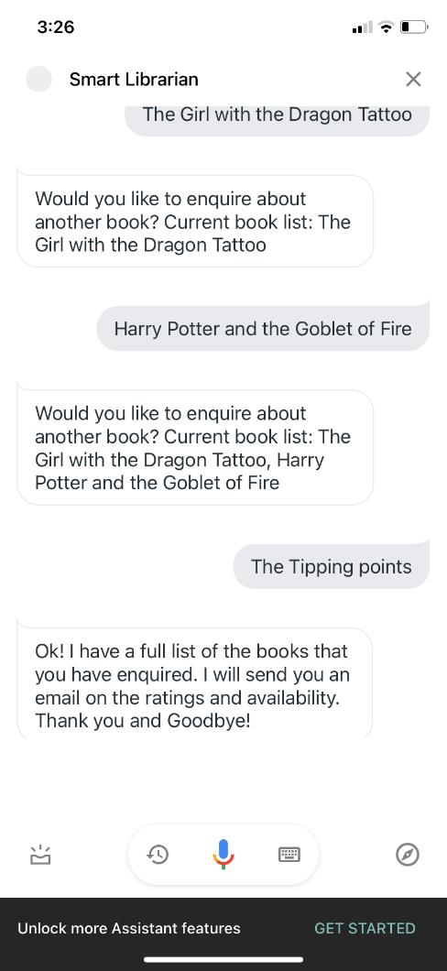
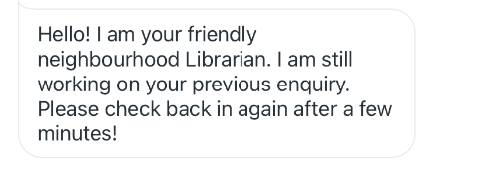
Conversational UI Architecture
Welcome Intent
Python Webhook Thread
Flask Library
Set Output Context:
Expecting Book Title
GetBookTitle Intent
Add to Book List
Set Output Context:
Follow up context – yes, no
No
Yes
Add to Book List
No
Set Output Context:
Follow up context – yes, no
Reset Context
Yes
Add to Book List
Book List Full
Reset Context
Triggers RPA Thread
Parallel RPA Thread
Trigger RPA
Welcome Intent
Ongoing query
Check presence of RPA Thread

Slide 6
NLB Availability Checker & Amazon Recommendation System

Slide 7
Intelligent Title Matcher Abstract Summarizer
Preload the
WORD2VEC model
on application startup
Preload the pre-trained
BERT model
on application startup
Receive Original Title
Remove STOPWORDS and TOKENIZE remaining words
Receive the
FULL TEXT to be abstracted
Receive FULL TEXT
Generate WORD VECTORS for each token
Parameterize the
MAX LENGTH
of abstract
Aggregate Word Vectors to TITLE VECTORS
Extract
KEY SENTENCES
from text
Return Matching Title
Find shortest
COSINE DISTANCE between Titles
Concatenate sentences to generate
ABSTRACT
Return ABSTRACT

Slide 8
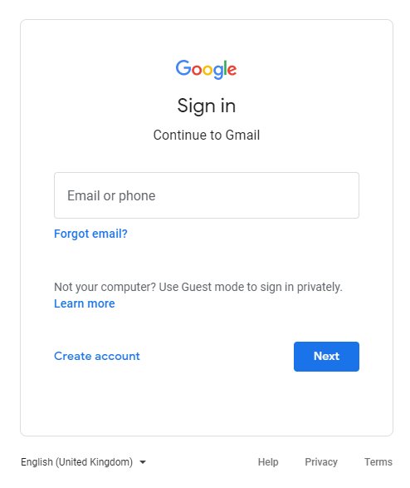
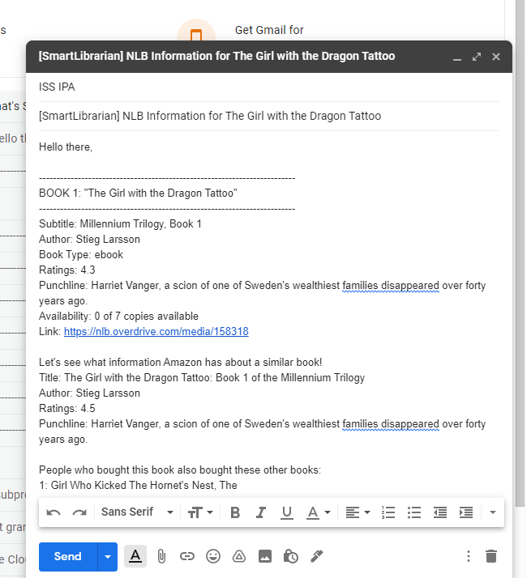

RPA: Email Agent
Direct to log in page for user to log in
Compose & Send Email
No
Amazon Information
Checks for Logged in Account
NLB Information
Yes
If no recipient detected in “email_recipient.txt”, obtain currently logged in email to store as recipient
Email Recipient

